Slide 1
Internship Training
Samarth Sharma

Slide 2
Week 1
Learnt about the basics of a Zynq SoC, how PS and PL are separated, what accelerators are, Vivado HLS workflow.
Also learnt the role of a DMA in converting MM to S and vice versa. Learnt about AXI Interfaces, AXI Stream, Master-Slave, handshaking (TVALID, TREADY), UART, DDR.
Implemented a simple HLS code to check for a key in an array.

Slide 3
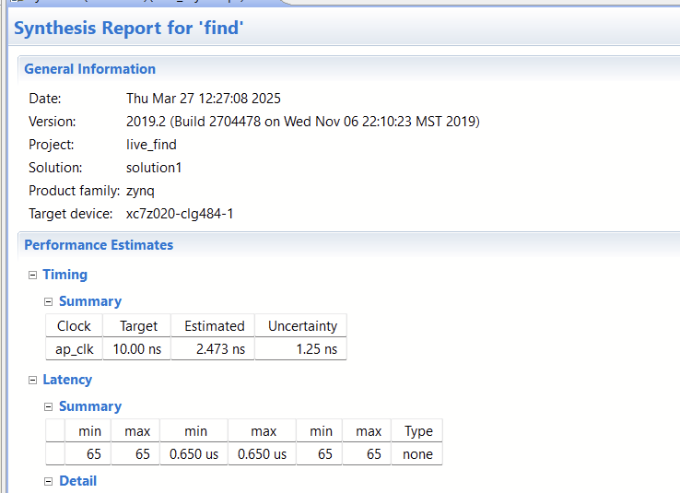
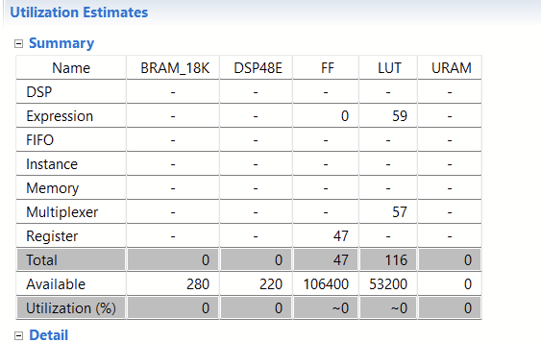

Slide 4
Week 2, 3
Implemented matrix multiplication in HLS using AXI Stream interface.
Started learning about latency optimizations.
Got familiar with terms like latency, Initiation Interval (II), Trip count.
Learnt about pragmas like LOOP_FLATTEN, PIPELINE, UNROLL, ARRAY_PARTITION.
Studied about Rewind and Flush.
Implemented matrix multiplication for 16x16 and higher sizes to compare and contrast differences.

Slide 5
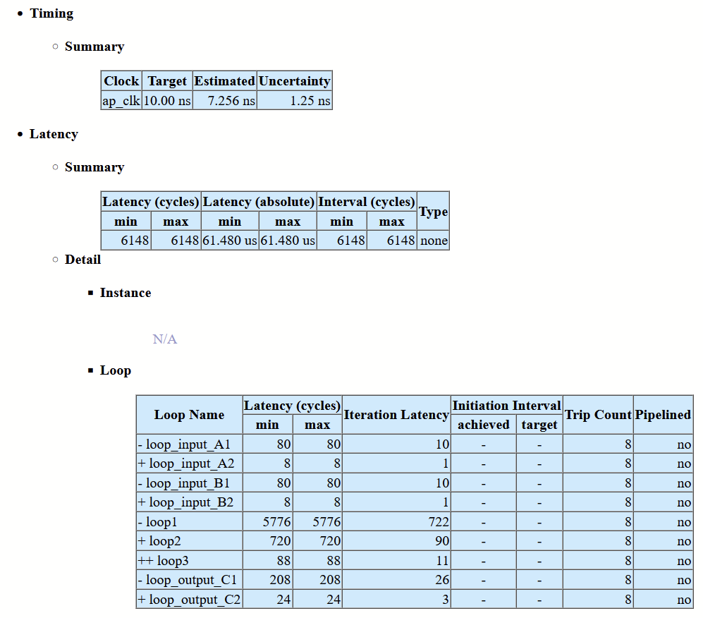
Solution 1 (no pipelining or other optimizations)

Slide 6
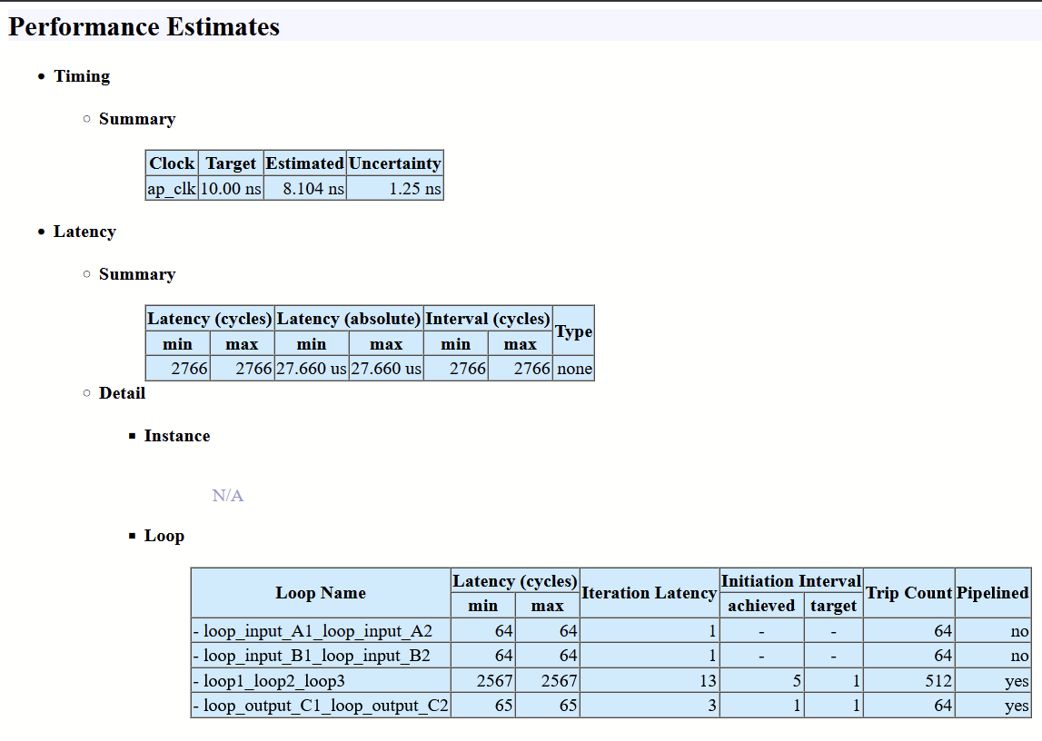
Solution 2 (with loop flattening, pipeline)

Slide 7
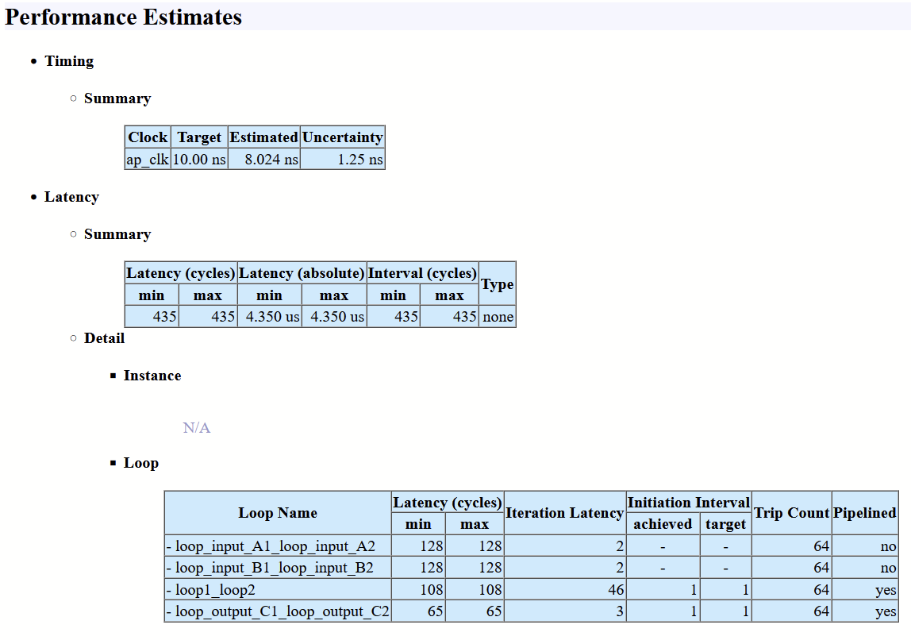
Solution 3 (Also added array partitioning and shifted #pragma PIPELINE before loop3, hence unrolling it)

Slide 8
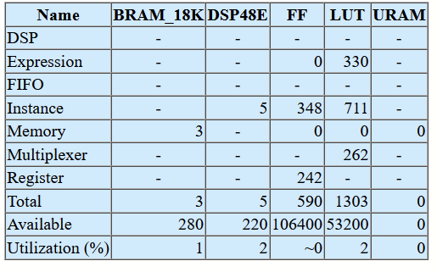
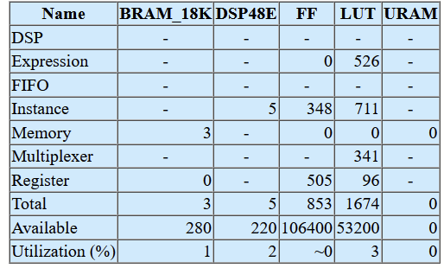
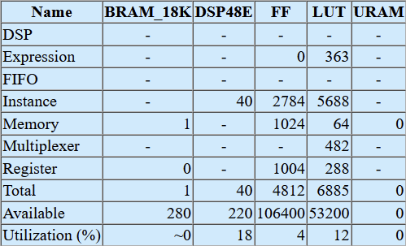
Latency-Resource tradeoff
Solution1
Solution2
Solution3

Slide 9
Week 4
Learnt about resource optimizations.
Implemented word length optimization.
Used <hls_half.h> and <ap_fixed.h> (ap_fixed <total bits, int bits>)
Played around with the number of bits in ap_fixed to get the optimal output.

Slide 10
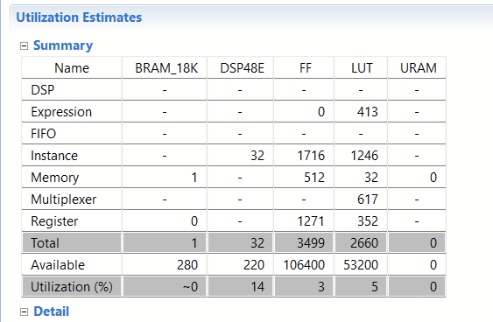
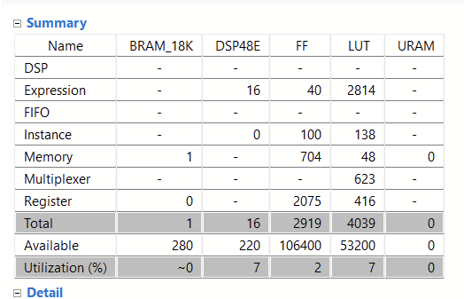
Solution 4 (<hls_half.h>)
Solution 5 (<ap_fixed.h>)
ap_fixed<22,12>

Slide 11
Week 5
Focused on Vivado Block Diagrams.
Implemented a FFT algo on vivado using the built-in IP.
Understood the role of DMAs, Interconnects, Smart Connects and other components like ILAs.
Learnt about the various ports like ACP, GP-HP, etc.
Generated bit-stream of the block diagram after creating HDL wrapper.

Slide 12
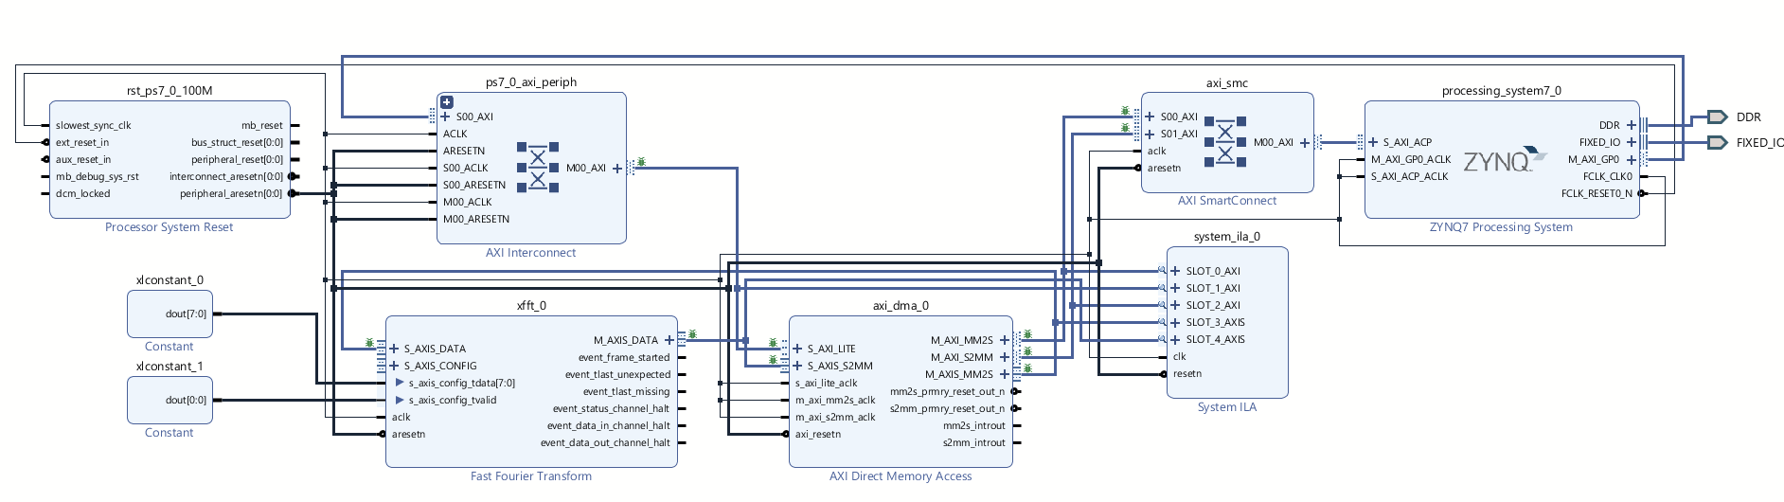

Slide 13
Thank You!!

